Slide 1


User-Driven Procedural Generation of 3D Environments
Capstone Project Presentation
Aymen HAMMAMI
2023-2024

Slide 2
Overview
1 | Project Context
2 | Problem Statement & Purpose
3 | Research Questions
4 | Methodology
6 | Results & Findings
7 | Project Demo
8 | Discussion
9 | Conclusion & Future Work
5 | Iterations
2

Slide 3
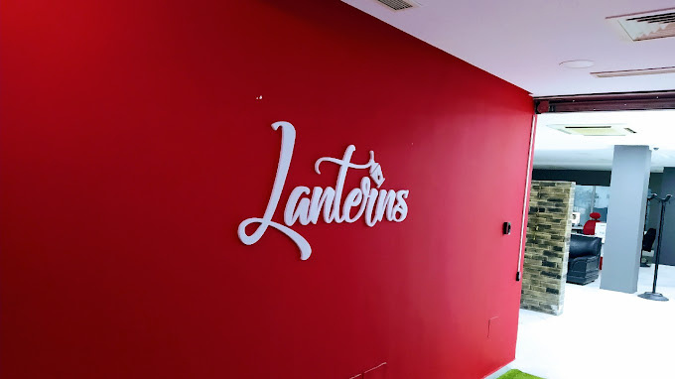
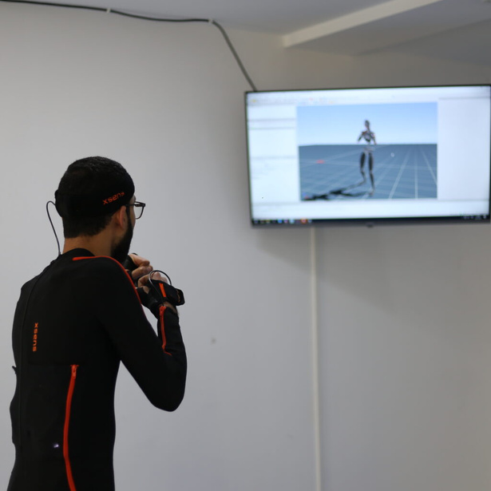
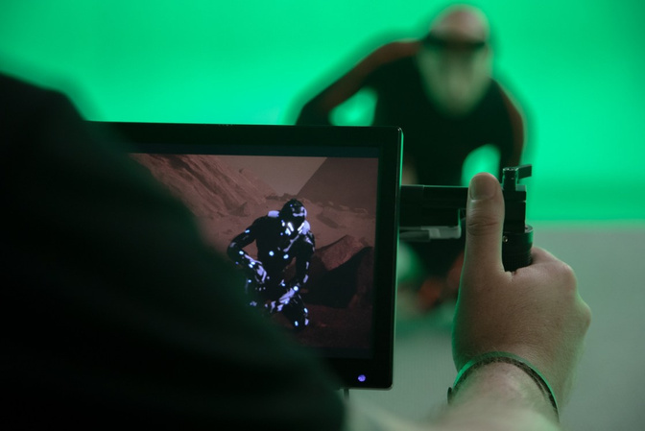
Project Context
Lanterns Studios: Founded in 2019, Based in Tunis
Offers mainly game development products and services
Can develop AR, MR or VR applications
First company in Tunisia to bring a complete motion capture solution
Key player in the Tunisian gaming industry
3

Slide 4
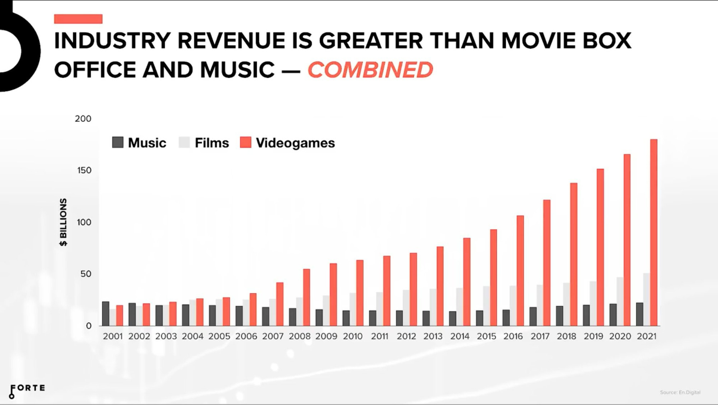
Project Context
Game industry revenue is greater than movie box office and music combined
More demand to create games, more demand for dev. tools and techniques
4

Slide 5





Project Context
Procedural generation automates the creation of many types of content
It has been used and researched in games since 1980
How does it work?
Randomness
Set of Rules
Controlled
Randomness
5

Slide 6


Problem Statement & Purpose
Problem Statement
Purpose
Increased need for creating 3D environments
User-driven tool that generates 3D environments
Traditional way is a long and challenging process
Use procedural generation and user prompts
Requires having expertise and skills with 3D design
Speed up the process = Save development time
Creating a 3D environment can be costy
Reduce costs and required level of knowledge
Small teams can’t even consider large scale ones
Offer new opportunities to small teams
6

Slide 7

What are the advantages and drawbacks of relying on procedural generation for 3D environment creation?
01
What are the key challenges in procedurally generating 3D environments that align with user expectations?
02
Research Questions
What features and requirements of the tool would be crucial to help streamline 3D environment creation and save development time?
03
7

Slide 8

Methodology
01
Problem
Investigation
05
01
04
Solution
Implementation
02
Solution
Design
Regulative Cycle
04
02
05
Solution
Evaluation
03
Design
Validation
03
8

Slide 9






Iteration #1
Procedural Content Generation System Implementation
Iterations
9

Slide 10




Layers of a 3D environment
RIVER
THEMES
FOLIAGE
BUILDINGS
10

Slide 11
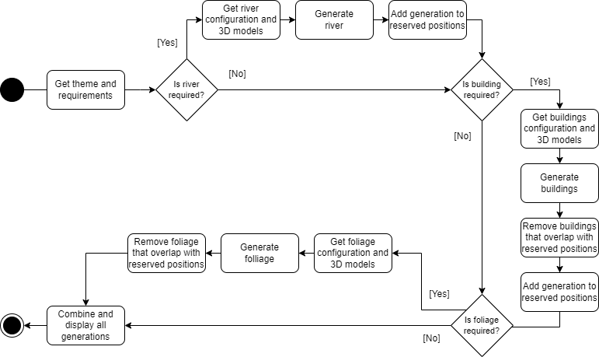
Environment Generation Workflow
11

Slide 12
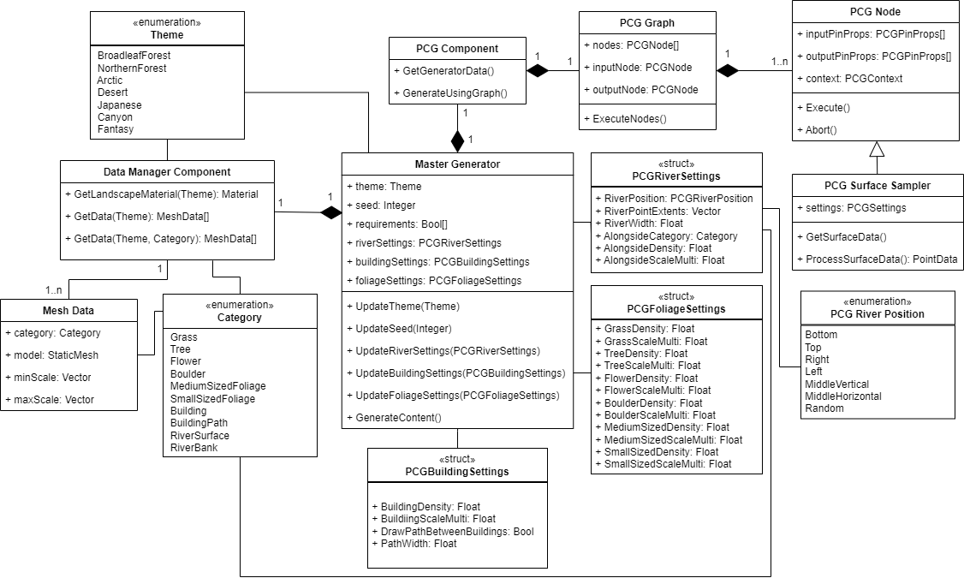
Class Structure of the System
12

Slide 13
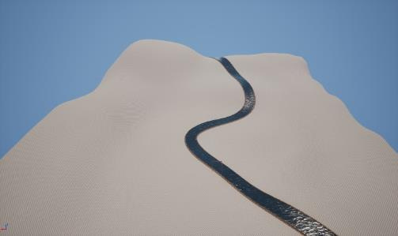
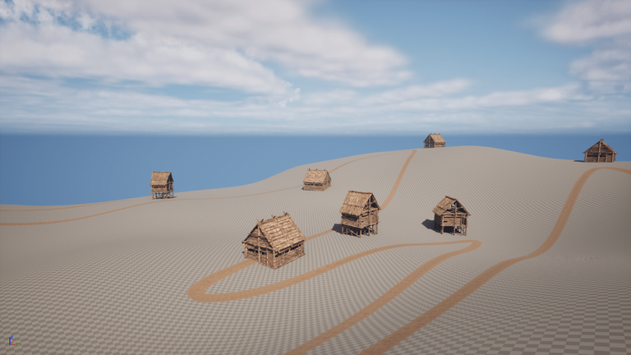
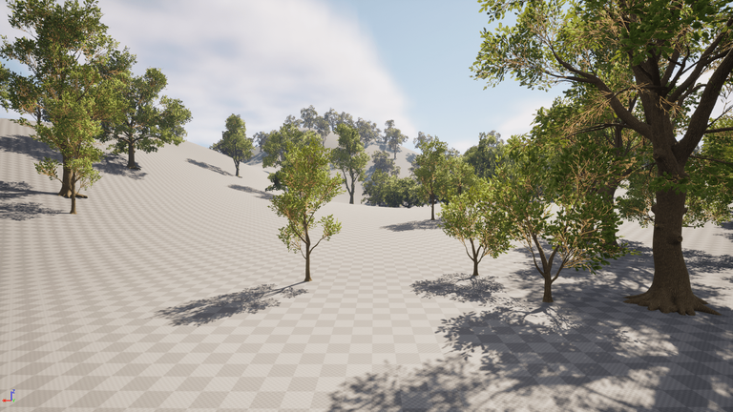
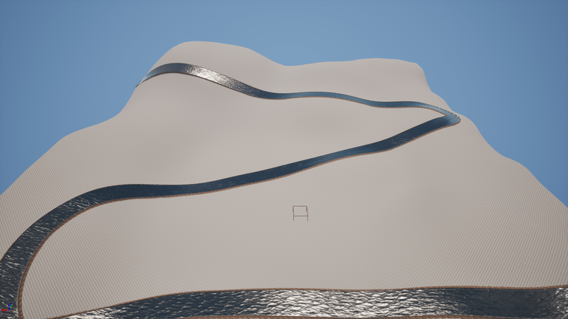
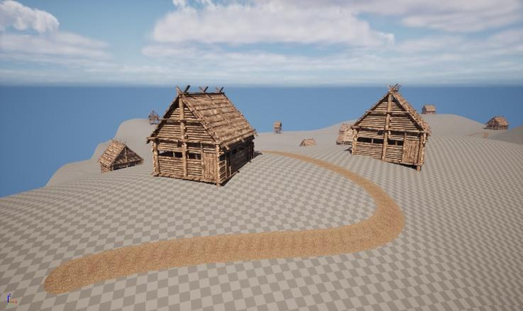
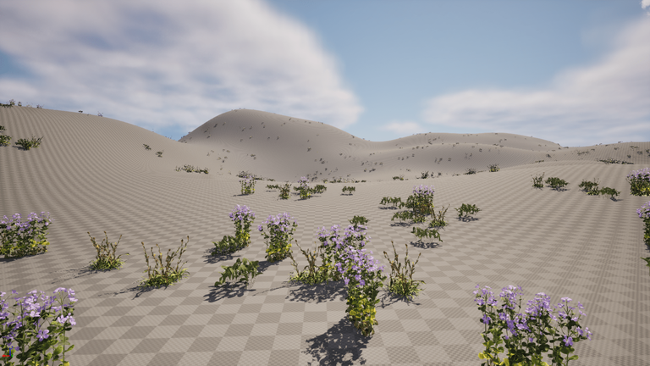
Results of PCG System
13

Slide 14
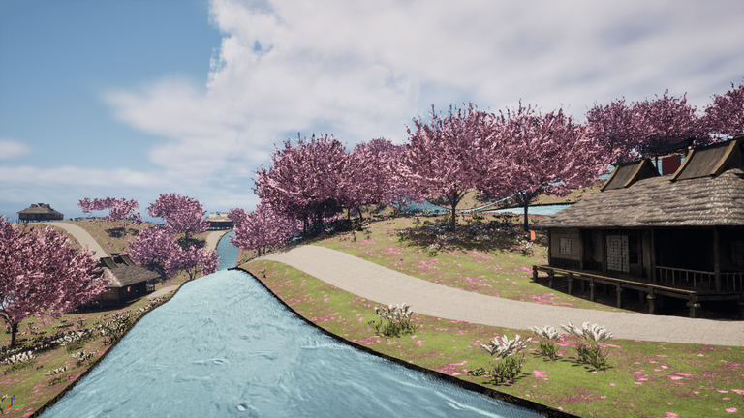
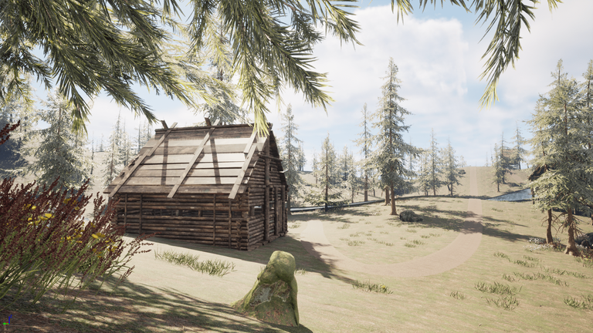
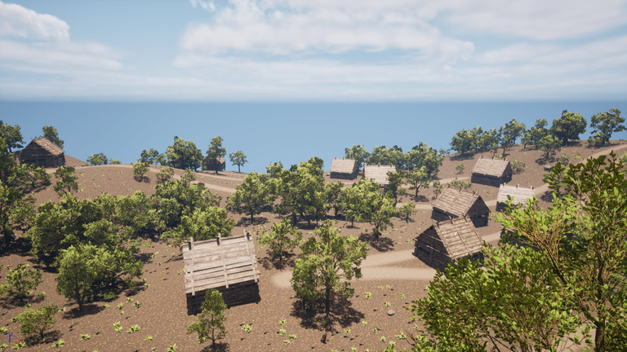
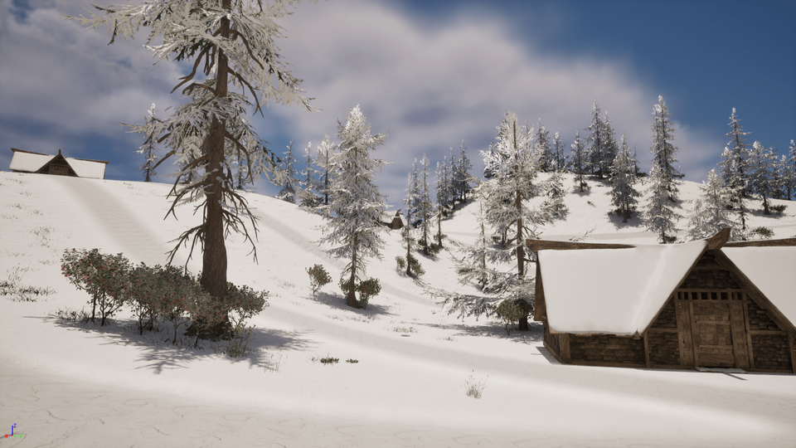
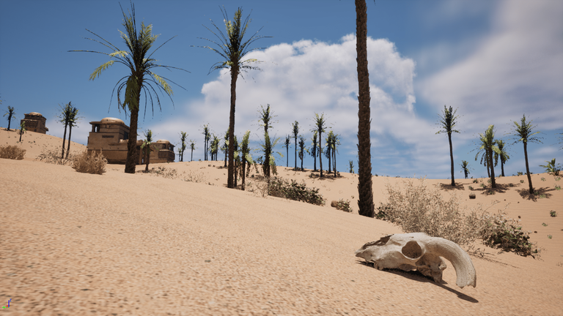
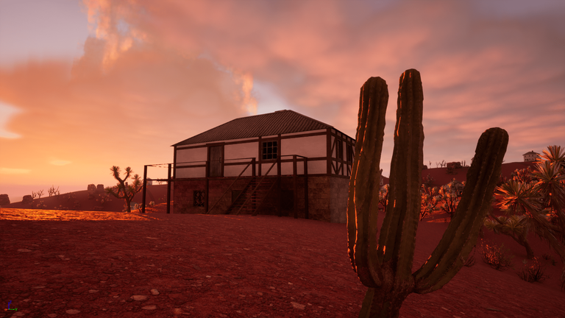
Results of PCG System
14

Slide 15
Iteration #2
Prompt Interpretation & Integration with the PCG System
Iterations
15

Slide 16
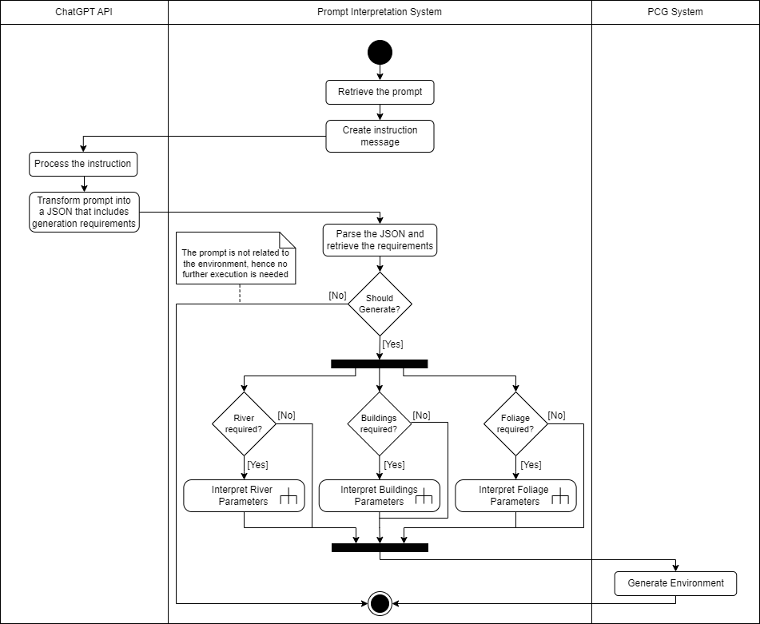
Process of Interpreting Initial Prompt
16

Slide 17
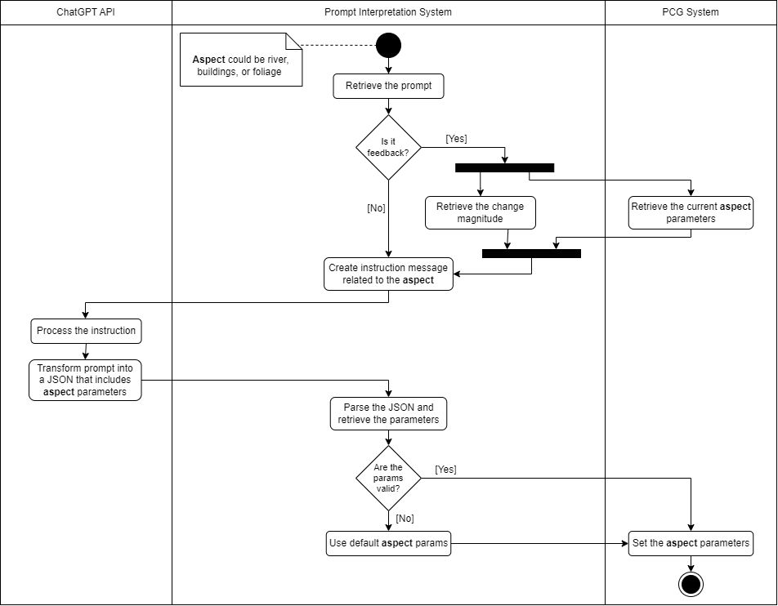
Process of Interpreting Parameters
17

Slide 18
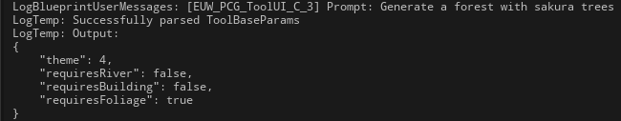
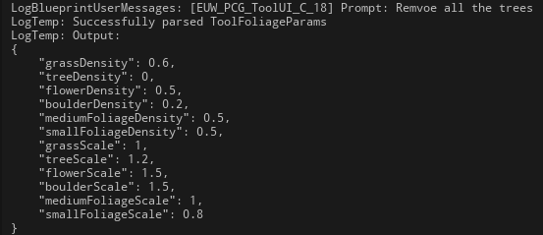
Results of Interpretation Process
18

Slide 19
Iteration #3
Tool’s UI/UX Design and Implementation
Iterations
19

Slide 20
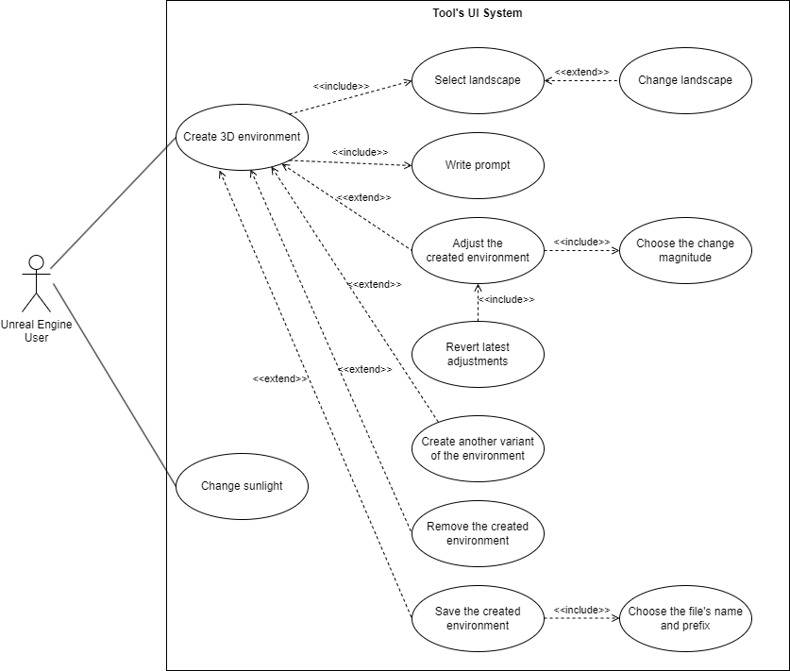
Use Case Diagram of the Tool’s UI
20

Slide 21
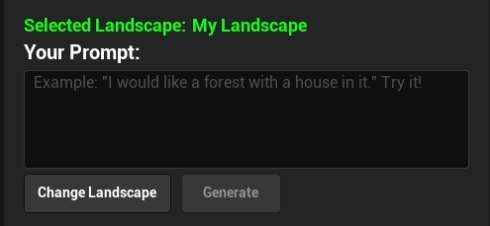
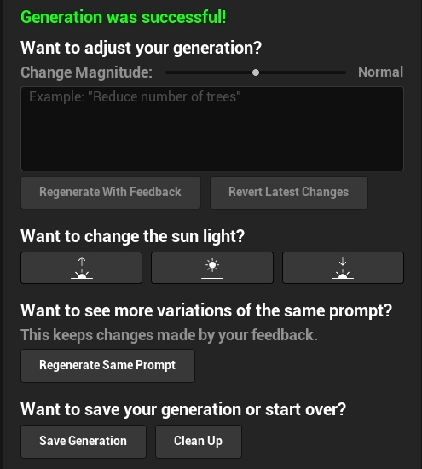




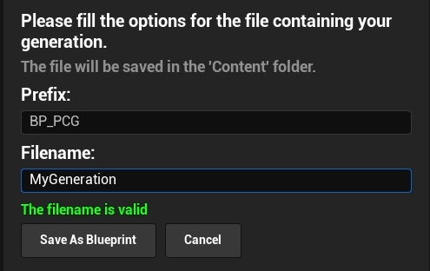
Results of Tool’s UI Implementation
21

Slide 22
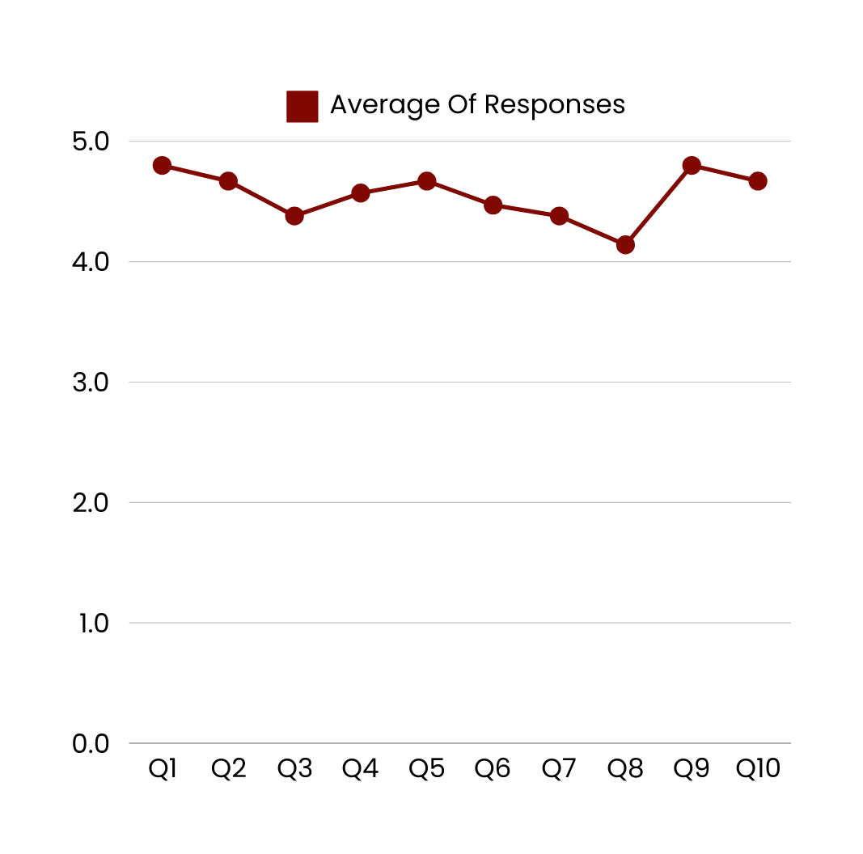
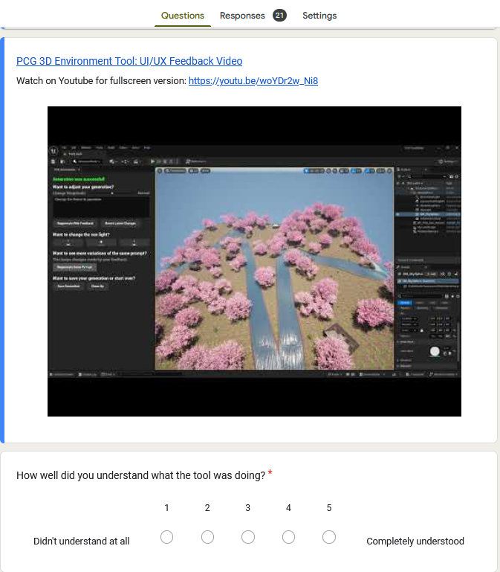
Survey about the Tool’s UI/UX
22

Slide 23


Results And Findings
01
What are the advantages and drawbacks of relying on procedural generation for 3D environment creation?
Advantages
Drawbacks
Time Efficiency
Implementation Complexity
Cost Reduction
Limited Uniqueness
Replayability
Unexpected Interactions
23

Slide 24




Results And Findings
02
What are the key challenges in procedurally generating 3D environments that align with user expectations?
Visual
Consistency
Believability
Audience
& Project Needs
Diversity
& Uniqueness
24

Slide 25





Results And Findings
03
What features and requirements of the tool would be crucial to help streamline 3D environment creation and save development time?
User-Friendly
Interface
Environment
Customization
Iterative
Process
Seamless
Integration
Performance
& Scalability
25

Slide 26
Project Demo
Switching to a video very soon!
26

Slide 27
Discussion
Impact on Research
Impact on Industry
Impact on Lanterns
Contribution to the field of procedural generation
Valuable info on 3D environment creation
New addition to dev. tools that integrate AI
Easier and faster 3D environment creation
Reduction in development costs
New opportunities for smaller teams
Possibility of additional revenue
Bonus to the company’s reputation in innovation
Improvement to development pipeline
Internal Validity
External Validity
Missing layer or important elements of 3D environments
Heavily dependent on Unreal Engine
27

Slide 28


Conclusion & Future Work
Conclusion
Future Work
Need to develop a user-driven 3D environment generation tool
More internal and external
testing & feedback
Contributed to field of PCG and tools with AI
More customization options
Achieved a fully functional version of that tool
New suggestion system
Is the basis for a future
monetizable version
28

Slide 29
Thank You
For Your Attention
Presented by Aymen HAMMAMI

